Slide 1
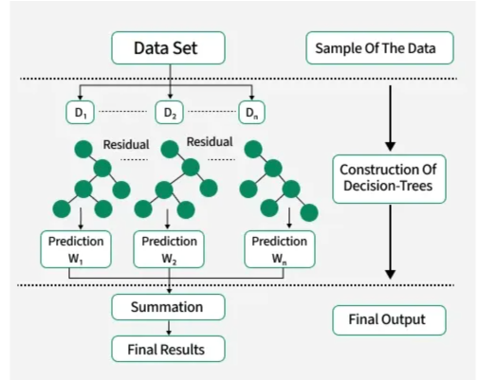
Machine Learning XG Boosting Algorithm
Diagram Representation of XGBoost
Extreme Gadient Boosting
It is a most powerful and fast machine learning algorithm which supports both regression and classification.
It builds a strong model by combining the output of many small decision trees.

Slide 2
Real Time Scenario
Lets Predict a Man’s Age
First guess: 30 → off by 10 years
Second guess: 30 + 5 = 35 → still off
Third guess: 35 + 4 = 39 → almost right
XGBoost : It corrects errors step-by-step by adding new trees that learn from the previous ones.

Slide 3
XG Boosting Algorithm - Applications
House Price Prediction – Estimate the price based on features like size, location.
We want to predict house price:
Size (sqft) | Bedrooms | Price ($K)
1400 | 3 | 250
1600 | 4 | 290
1700 | 3 | 310
First model guesses all prices = average = 283K
Errors = [-33, +7, +27]
Next tree tries to predict these errors
Model adjusts predictions step-by-step using gradient descent

Slide 4
Advantages and Disadvantages
Advantages of XGBoosting
Trains the model faster when compared to Adaboosting
Very High Accuracy
Works for both numerical & categorial data
Avoids Overfitting
Disadvantages of XGBoosting
More complex to tune
Can overfit on very small datasets
Difficult to interpret (ensemble of many trees)

Slide 5
Installation of xgboost library
Install a new library called xgboost
from xgboost import XGBRegressor
model = XGBRegressor(n_estimators=100, learning_rate=0.1, random_state=42)
model.fit(X_train, y_train)
Procedure for XGBoosting

